Slide 1
Decision making
Dr F. McNicholl
05/10/18

Slide 2


Slide 3
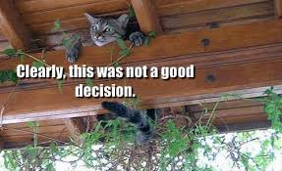

Slide 4
Are you good at decision making?

Slide 5
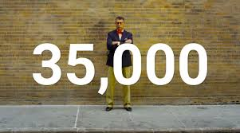

Slide 6


Slide 7
Scenario 1
73 year old man
On Bortezomib - dexamethasone chemotherapy for myeloma
Cycle 4 d22 chemotherapy

Slide 8
Scenario 1
During cycle, withhold treatment if: PLT<25 or Neutrophils < 0.75
Hb 98g/l, PLT 21, Neutrophils 0.2
Do you proceed with chemo?
Yes or No?

Slide 9
How did you go about making that decision?

Slide 10
What are the characteristics of a good decision maker?

Slide 11
Objective
Analytical
Consistent
Calm
Unemotional
Safe
Rational

Slide 12
Rational decision making model
Rational decision making favors objective data and a formal process of analysis over subjectivity and intuition.

Slide 13
Rationale Model assumes:
An individual has full and perfect information on which to base a choice.
Measurable criteria exist for which data can be collected and analyzed.
An individual has the cognitive ability, time, and resources to evaluate each alternative against the others.

Slide 14
Who makes decisions like that?

Slide 15
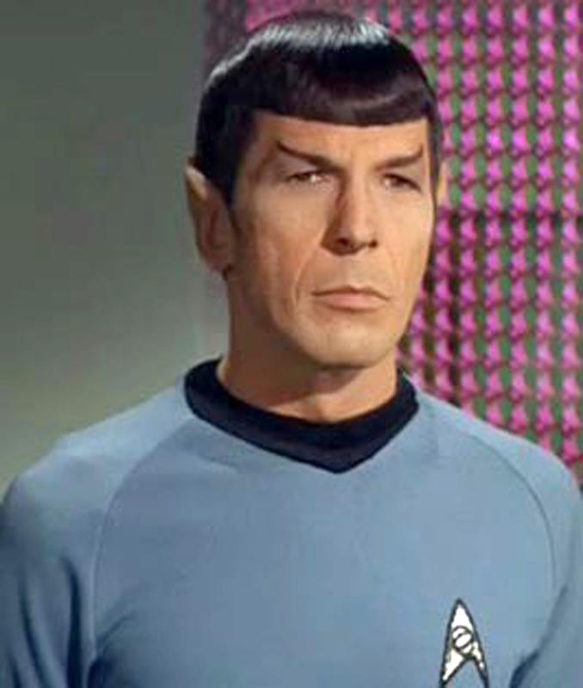

Slide 16
Scenario 2
73 year old man
On Bortezomib dexamethasone chemotherapy for myeloma
Cycle 4 d22
Hb 98g/l, PLT 24, Neutrophils 0.72
Do you proceed with chemo?
Yes or No?

Slide 17
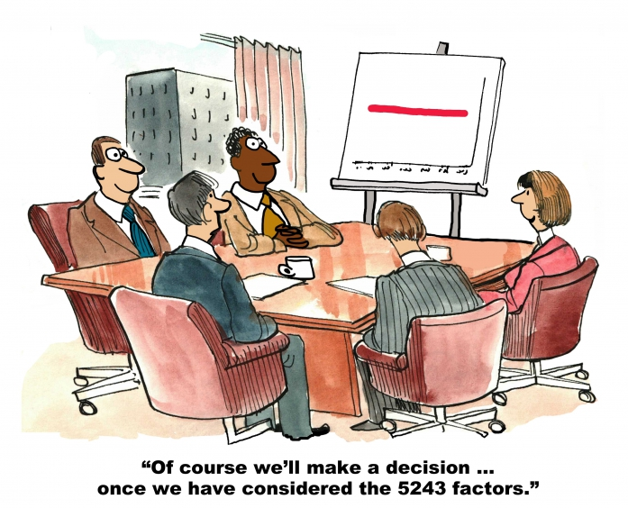

Slide 18
Scenario 3
Mary is 73 years old.
Has myeloma, 5th line therapy with Bortezomib Dex,
C4 Day 22
Hb 98g/l, PLT 24 Neutrophils 0.72

Slide 19
A bit more information…..

Slide 20
Mary’s daughter and son-in-law died in a car crash 24 years ago

Slide 21
Leaving a 3 year old daughter, Jane, orphaned

Slide 22
Mary and her husband Brian then raised their granddaughter, Jane

Slide 23
Jane is getting married in 3 days

Slide 24
Mary’s bone pain settles for 4 days after chemo
Mary and Brian beg you for the chemo

Slide 25
Do you proceed with chemo?
Yes or No?

Slide 26
How did you feel making this decision?

Slide 27
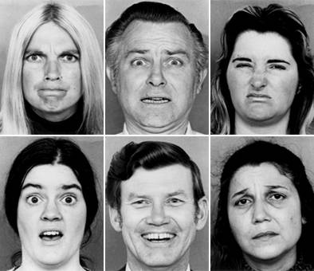
What emotion are they experiencing?

Slide 28
Neuroscience

Slide 29
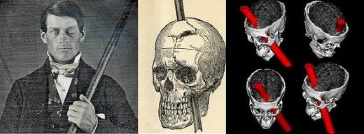
Phineas Gage
13th September 1848, Vermont

Slide 30
“He is fitful, irreverent, indulging in the greatest profanity”, “Mind radically changed”,
“Couldn’t stick to plans” “No longer Gage”
Only 4% of his cerebral cortex was damaged
Accident damaged connections between the frontal cortex and limbic system which are involved in the regulation of emotions

Slide 31
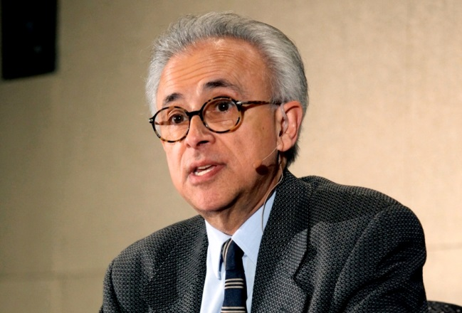
Antonio Damasio
Professor of Neuroscience, Psychology and Neurology
University of Southern California

Slide 32
The Story of Elliott
A successful businessman.
Model father and husband.
Developed a brain tumour,
As a result of a brain tumor and surgery Elliott suffered ventromedial frontal lobe damage

Slide 33
His cancer was cured

Slide 34
BUT…..

Slide 35
Following his operation:
Elliot dispassionately reported to Damasio that his life was falling apart.

Slide 36
While still in the 97th percentile for IQ, Elliot lacked all motivation.
His marriage collapsed as did each new business he started.

Slide 37
“I never saw a tinge of emotion in my many hours of conversation with him: no sadness, no impatience, no frustration.”
“Elliott emerged as a man with a normal intellect who was unable to decide properly, especially when the decision involved personal or social matters.”

Slide 38
Even small decisions were fraught with endless deliberation:
Making an appointment took 30 minutes
Choosing where to eat lunch took all afternoon
Deciding which color pen to use to fill out office forms was very difficult
His lack of emotion paralyzed his decision-making

Slide 39
“Today this idea [that emotion assists the reasoning process] does not cause any raised eyebrows among neuroscientists, but I believe it’s still a surprise to the general public.”
“We’re trained to regard emotions as irrational impulses that are likely to lead us astray.”

Slide 40
“When we describe someone as “emotional,” it’s usually a criticism that suggests that they lack good judgment.”
“And the most logical and intelligent figures in popular culture are those who exert the greatest control over their emotions–or who seem to feel no emotions at all.”

Slide 41
The Literature on Emotion and Clinical Decision Making

Slide 42
Subjective experience of emotion
Emotional response to contextual pressures
Emotional responses to others
Intentional exclusion of emotion form clinical decision making

Slide 43
Application of emotion and cognition in clinical decision making
Compassionate emotional labour
Responsiveness to patient emotion within CDM
Interdisciplinary tension regarding the significance and meaning of emotion in CDM
Emotion and moral judgement

Slide 44
Emotional contexts of decision making includes the need to manage stress and anxiety emerging from uncertainty
Participants said their reluctance to make decisions stemmed from their conviction that causing harm by omitting treatment was somehow superior to causing harm by offering the wrong treatment.
Tallentire Med Educ 2011;45(10):995-1005

Slide 45
Clinicians largely aimed to separate emotion from clinical decision making
40% agreed that other clinicians experienced a negative effect on their clinical decisions as a result of emotions
Only 21.1% thought the same applied to themselves
Lafrance Robinsone et al Eat Disord. 2015;23(2):163-76

Slide 46
Interdisciplinary differences (1)
Empathy and compassion for patients acted as powerful motivation to provide holistic care interventions
Nurses spent longer talking about patient emotions during the consultation

Slide 47
Interdisciplinary differences (2)
Nurses spent more time listening and offering support to the patient
Emotional self awareness and emotional reasoning were employed to clarify intuition and gut feelings

Slide 48
Emotions can negatively affect CDM
Uncertainty is a key feature of the emotional context of Clinical Decision Making and, in medical practice, has been strongly associated with stress and fear, with denial being a common defence mechanism
Ghosh et al j lab clin med 2004;144(2)60-4

Slide 49
Differences in Medical and Nursing literature
Tendency for physicians to allow the emotional content of clinical situations to go unacknowledged
The emotional and patient advocacy aspects of Clinical Decision Making feature more strongly in the nursing literature

Slide 50
Acknowledgement and mastery of the emotional aspect of Clinical Decision Making has been suggested as a critical element to improving patient safety
High variation in the integration of emotional awareness and competence with the cognitive aspects in Clinical Decision Making

Slide 51
Which leads us to……….

Slide 52
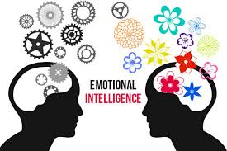

Slide 53
Emotional Intelligence
1). Capability to recognise your own emotions and those of others
2). Discern between different feelings and label them appropriately

Slide 54
Emotional Intelligence
3). Use emotional information to guide thinking and behaviour
4). Manage and/or adjust emotions to adapt environments or achieve one’s goals

Slide 55
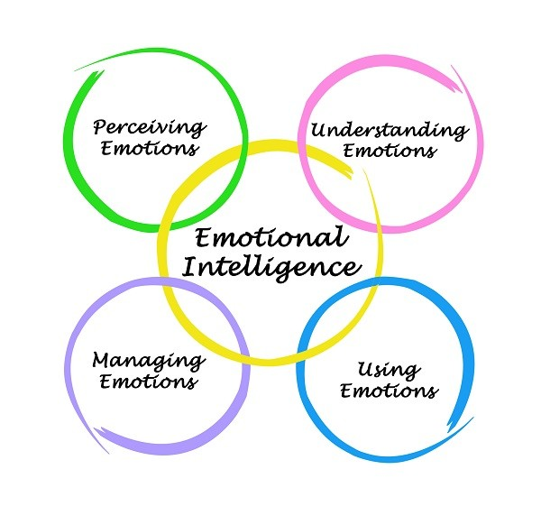

Slide 56
Emotional intelligence benefits
Building emotional capabilities may be an effective step towards increasing patient safety and clinicians’ feelings of self-efficacy

Slide 57
Emotional intelligence benefits
Associated with improved outcomes in:
  Work wellness
  Lower stress
  Staff retention
  Inter-disciplinary team-work
  Clinical teaching effectiveness
  Overall clinical performance

Slide 58
How emotionally intelligent are you?

Slide 59
Emotional Intelligence assessment tools

Slide 60
Not at all, Rarely,
Sometimes, Often, Very often
1) I can recognise my emotions as I experience them

Slide 61
Not at all, Rarely,
Sometimes, Often, Very often
2) I lose my temper when I feel frustrated

Slide 62
Not at all, Rarely,
Sometimes, Often, Very often
3) People have told me that I’m a good listener

Slide 63
Not at all, Rarely,
Sometimes, Often, Very often
4) I know how to calm myself down when I feel anxious or upset

Slide 64
Not at all, Rarely,
Sometimes, Often, Very often
5) I enjoy organising groups

Slide 65
Not at all, Rarely,
Sometimes, Often, Very often
6) I find it hard to focus on something over the long term

Slide 66
Not at all, Rarely,
Sometimes, Often, Very often
7) I find it difficult to move on when I feel frustrated or unhappy

Slide 67
Not at all, Rarely,
Sometimes, Often, Very often
8) I know my strengths and weaknesses

Slide 68
Not at all, Rarely,
Sometimes, Often, Very often
9) I avoid conflict and negotiations

Slide 69
Not at all, Rarely,
Sometimes, Often, Very often
10) I feel that I don’t enjoy my work

Slide 70
Not at all, Rarely,
Sometimes, Often, Very often
11) I ask people for feedback on what I do well, and how I can improve

Slide 71
Not at all, Rarely,
Sometimes, Often, Very often
12) I set long term goals, and review my progress regularly

Slide 72
Not at all, Rarely,
Sometimes, Often, Very often
13) I find it difficult to read other people’s emotions

Slide 73
Not at all, Rarely,
Sometimes, Often, Very often
14) I struggle to build rapport with others

Slide 74
Not at all, Rarely,
Sometimes, Often, Very often
15) I use active listening skills when people speak to me.

Slide 75
Emotional intelligence can be thought of as a set of emotional competencies compatible with emotionally informed cognition

Slide 76
GOOD NEWS!!

Slide 77
It is possible to increase Emotional intelligence……..

Slide 78


Slide 79
Summary
Emotions are critical to decision making process
Empathy and compassion enable you to connect with patients
Emotions are essential to your ability to connect
You make better decisions if you have emotionally connected

Slide 80
Another thing about emotions and decisions…..

Slide 81
Jessica Lloyd MD
Soon after she began her career as a pediatric critical care physician, she realized she wasn't prepared for one aspect of the job:
The Emotional Trauma.

Slide 82
In particular, she was struck when a 7-year-old cancer patient she was caring for unexpectedly took a turn for the worse.
As he died, she watched his father hold his hand as he repeated, "I love you so much. I love you so much.“

Slide 83
"After the boy died, I kept hearing those words in my head," says Lloyd, holding back tears five years after the incident.
"We didn't think he was going to die, and I felt so sad.”

Slide 84
“It was a surreal moment because it was such a painful loss, yet I had to go on to the next patient."

Slide 85
Emotions can be overwhelming, but developing emotional intelligence helps build resilience

Slide 86
What did Jessica Lloyd do?

Slide 87
Resilience Training Program
Inspirational goal setting and problem- solving (defining a larger purpose related to the current stress/trauma that reminds people of their values and long-term goals)
Reflective timeline narrative (writing about a traumatic event to integrate thoughts and emotions and identify patterns of thought and behavior)
Emotion regulation: attention control and cognitive reappraisal
Communicating with angry or highly distressed patients and parents
How to recognize symptoms of depression, trauma and burnout and resources for self-management and support

Slide 88
Another thing to be aware of:

Slide 89
Decision Fatigue

Slide 90
Ben Gurion University and Columbia University
Studied factors affecting the probability that Israeli prisoners who were going before a judge for a parole hearing would be set free

Slide 91
Looked at factors which decided if a prisoner was granted parole
1,100 decisions over the course of a year
Crime committed?
The length of the sentence?
Ethnicity of the offender?

Slide 92
“The time of day the prisoner stood in front of the judge”

Slide 93
Decision Fatigue
The prisoners who appeared later in the day were less likely to be released on parole than those who appeared in the morning.
The judges were not treating prisoners unfairly on purpose.
The mental work required to rule on case after case all day wore each judge down, weakening the ability to make a good decision.

Slide 94
Dealing with Decision Fatigue
Simply the choices you need to make throughout the day (use routine)
Schedule your day so as you are making big decisions when your motivation and willpower are high (BMA, June 2016)

Slide 95
Another effective technique to combat decision fatigue…..

Slide 96
Have an afternoon nap!!!

Slide 97
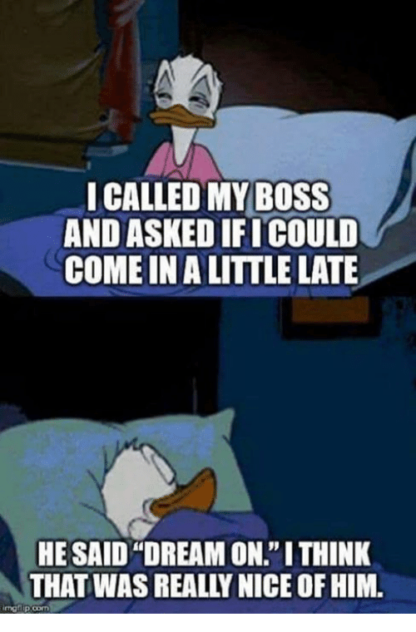

Slide 98
Summary
You need your emotions to make good decisions
Being aware of them is a good start
Empathy and compassion improve decisions
Build your emotional intelligence
Be aware of emotional trauma
Be aware of decision fatigue

Slide 99


